Slide 1
The Navigation Menu in a React/Next.js Project
Nku Bende – Danny Brien

Slide 2
Prior Knowledge
No prior use of this component before this assignment

Slide 3
Resources Consulted
Radix-ui official documentation
YouTube
Stack Overflow
Search engine (where sandbox demo was found)

Slide 4
Collaboration
Google Meet
GitHub
Pair programming
Discord – Exchange of documentation
Progress updates

Slide 5
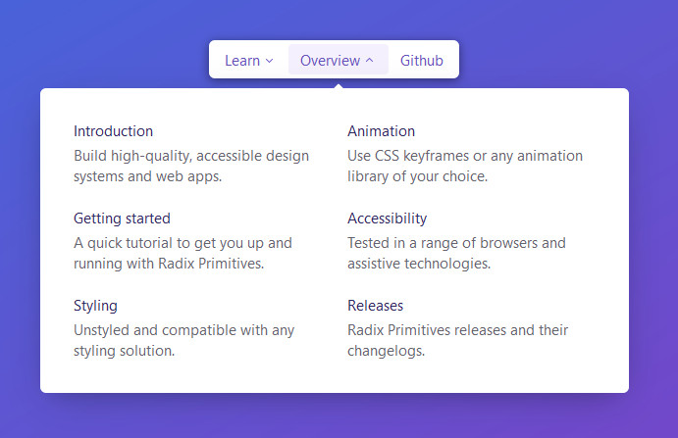
Original Demonstration

Slide 6
Demonstration
Use case one: As a user without a physical disability
Use case two: As a user that can only use a keyboard

Slide 7
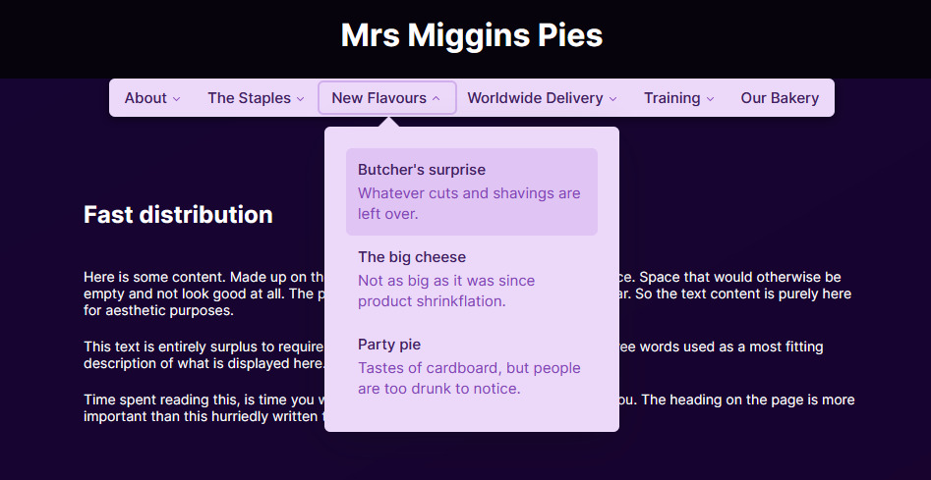
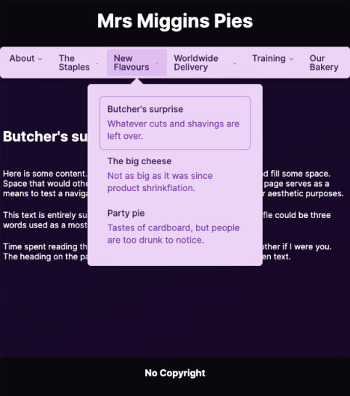
Responsive

Slide 8
Setup
Create a new Nextjs/React project
locally using npm in the console:
Install the following dependencies:
npx create-next-app@latest
npm install @radix-ui/react-navigation-menu
npm install @radix-ui/themes
npm install @radix-ui/react-icons
npm install classnames
npm install @stitches/react

Slide 9
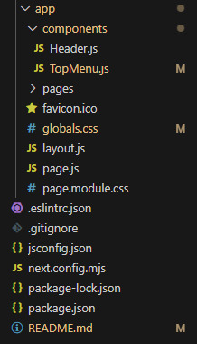
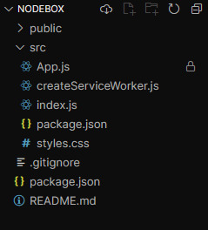
Files to Transfer
"use client";
https://codesandbox.io/p/sandbox/radix-ui-nav-menu-8r4sx4

Slide 10
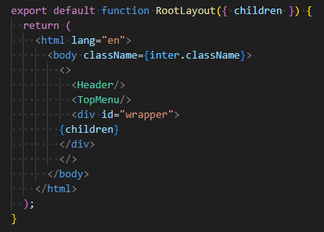
Including Menu Component

Slide 11
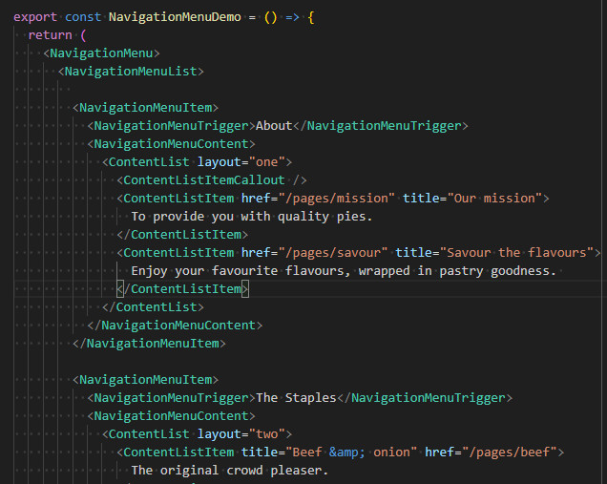
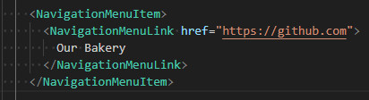

Quick Wins
Where the menu is assembled:
The most basic menu button
(no dropdown):

Slide 12
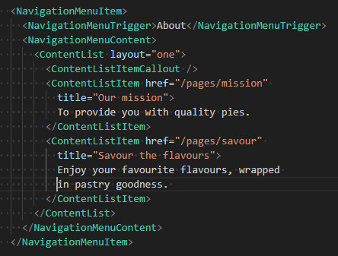
Component | Description
<NavigationMenuItem> | Surrounds the parent menu button.
<NavigationMenuTrigger> | Contains the heading and triggers the sub-menu.
<NavigationMenuContent> | Contains the sub menu entries.
<ContentList layout=“x”> | “x” defines what style template you apply to the sub-menu. New ones can be created elsewhere in the code, in the ContentList object. Contains data such as the width, how many columns, etc.
<ContentListItemCallOut> | This is the code that creates the menu entry that is a coloured box with internal text.
<ContentListItem> | The information for each sub-menu entry. Set title, description and link here.

Slide 13
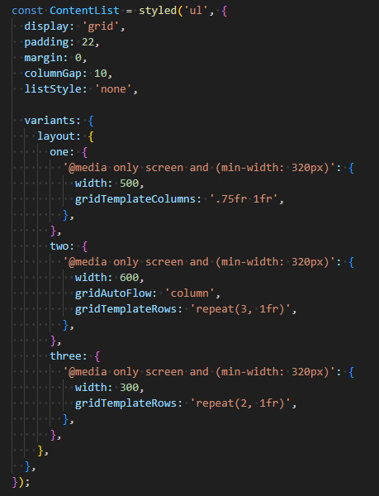

Slide 14
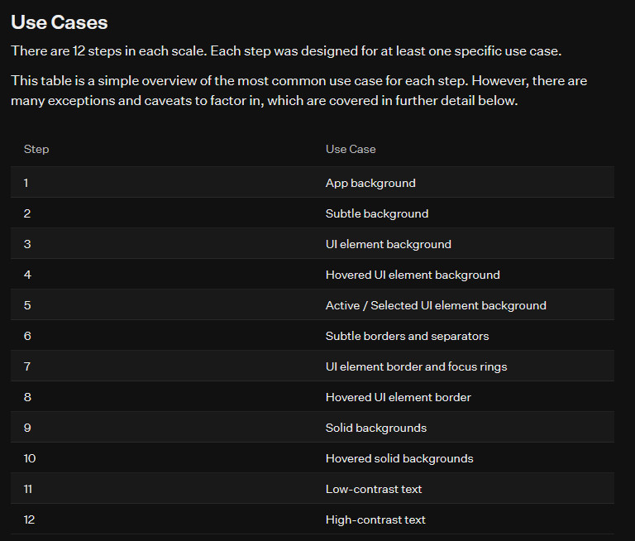
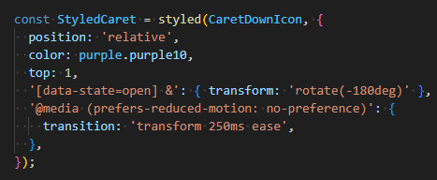
Radix-ui Colours
Purple.purple1 = lightest hue
to
Purple.purple12 = darkest hue

Slide 15
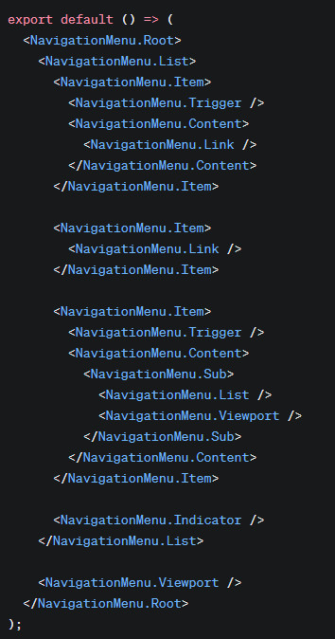
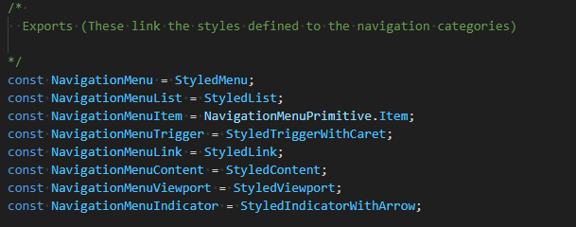
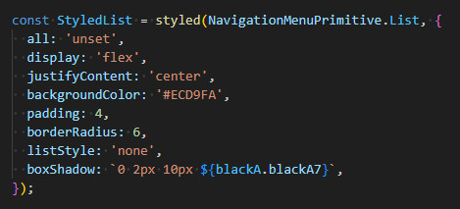
Demo Code Mapping
Sandbox
code
Official
code

